Slide 1
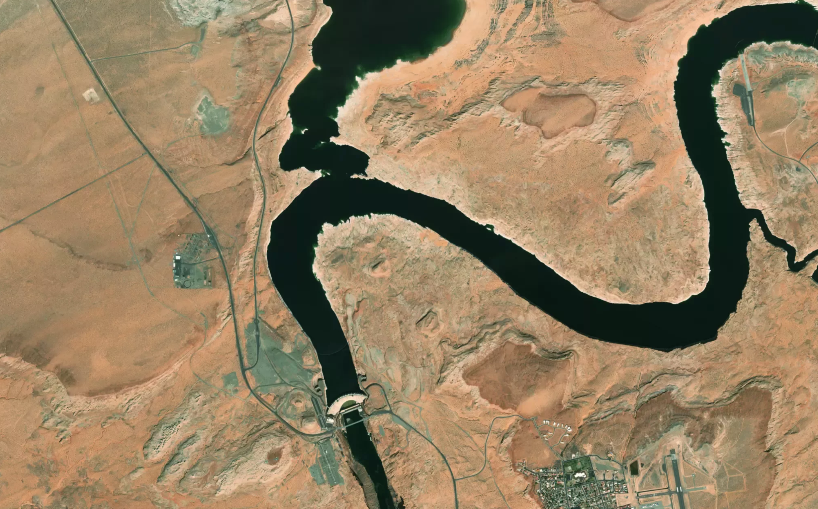
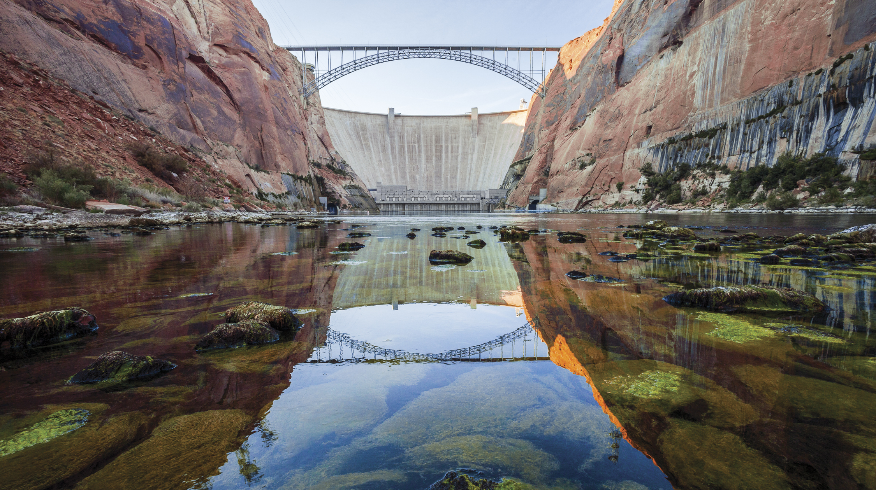





Characterizing the fish assemblage in the Lake Powell forebay and identifying the potential for nonnative fish escapement into the Lower Colorado River
Barrett Friesen, Phaedra Budy, Casey Pennock
Utah State University
Notes:
Hello and thank you for the introduction, some of you I’ve met before, and for those I haven’t I’m a master’s student at Utah State, under co-advsiors Phaedra Budy and Casey Pennock. I’m pleased to be here to share some findings from the first year of my project. In this project I am examining the possibility of nonnative fishes to become entrained in Glen Canyon Dam and end up in the lower CO River

Slide 2
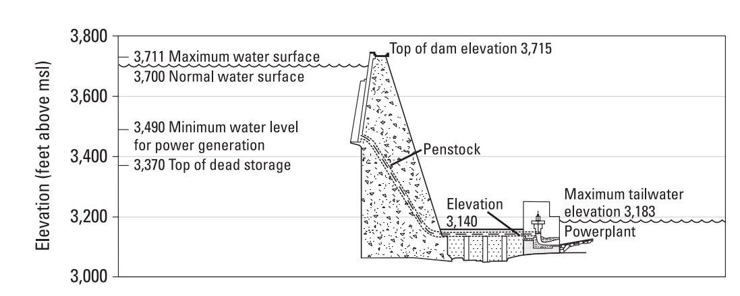

Historic conditions: withdrawal from hypolimnion when stratified
Epilimnion
Hypolimnion
flow
Notes:
Historically, as shown here, water levels were high enough that the dam penstock pulled water from the cold and oxygen poor hypolimnion, where the risk of entrainment was low

Slide 3
Current conditions: withdrawal from epilimnion when stratified
Current level: 3520 ft
Epilimnion
Hypolimnion
flow
Notes:
However, the recent lowering water level has brought the warm and productive epilimnion into contact with the penstock, increasing the likelihood of nonnative fish entrainment. Entrained fish would be carried down the penstock to the spinning hydroelectric turbines, and from there be discharged into the river tailwater below. The irony of the situation is that discharge from the warm epilimnion has actually improved conditions for the native river fishes below the dam, but any benefits they gain from warmer water could be offset by the invasion of additional nonnative fish into the river.

Slide 4
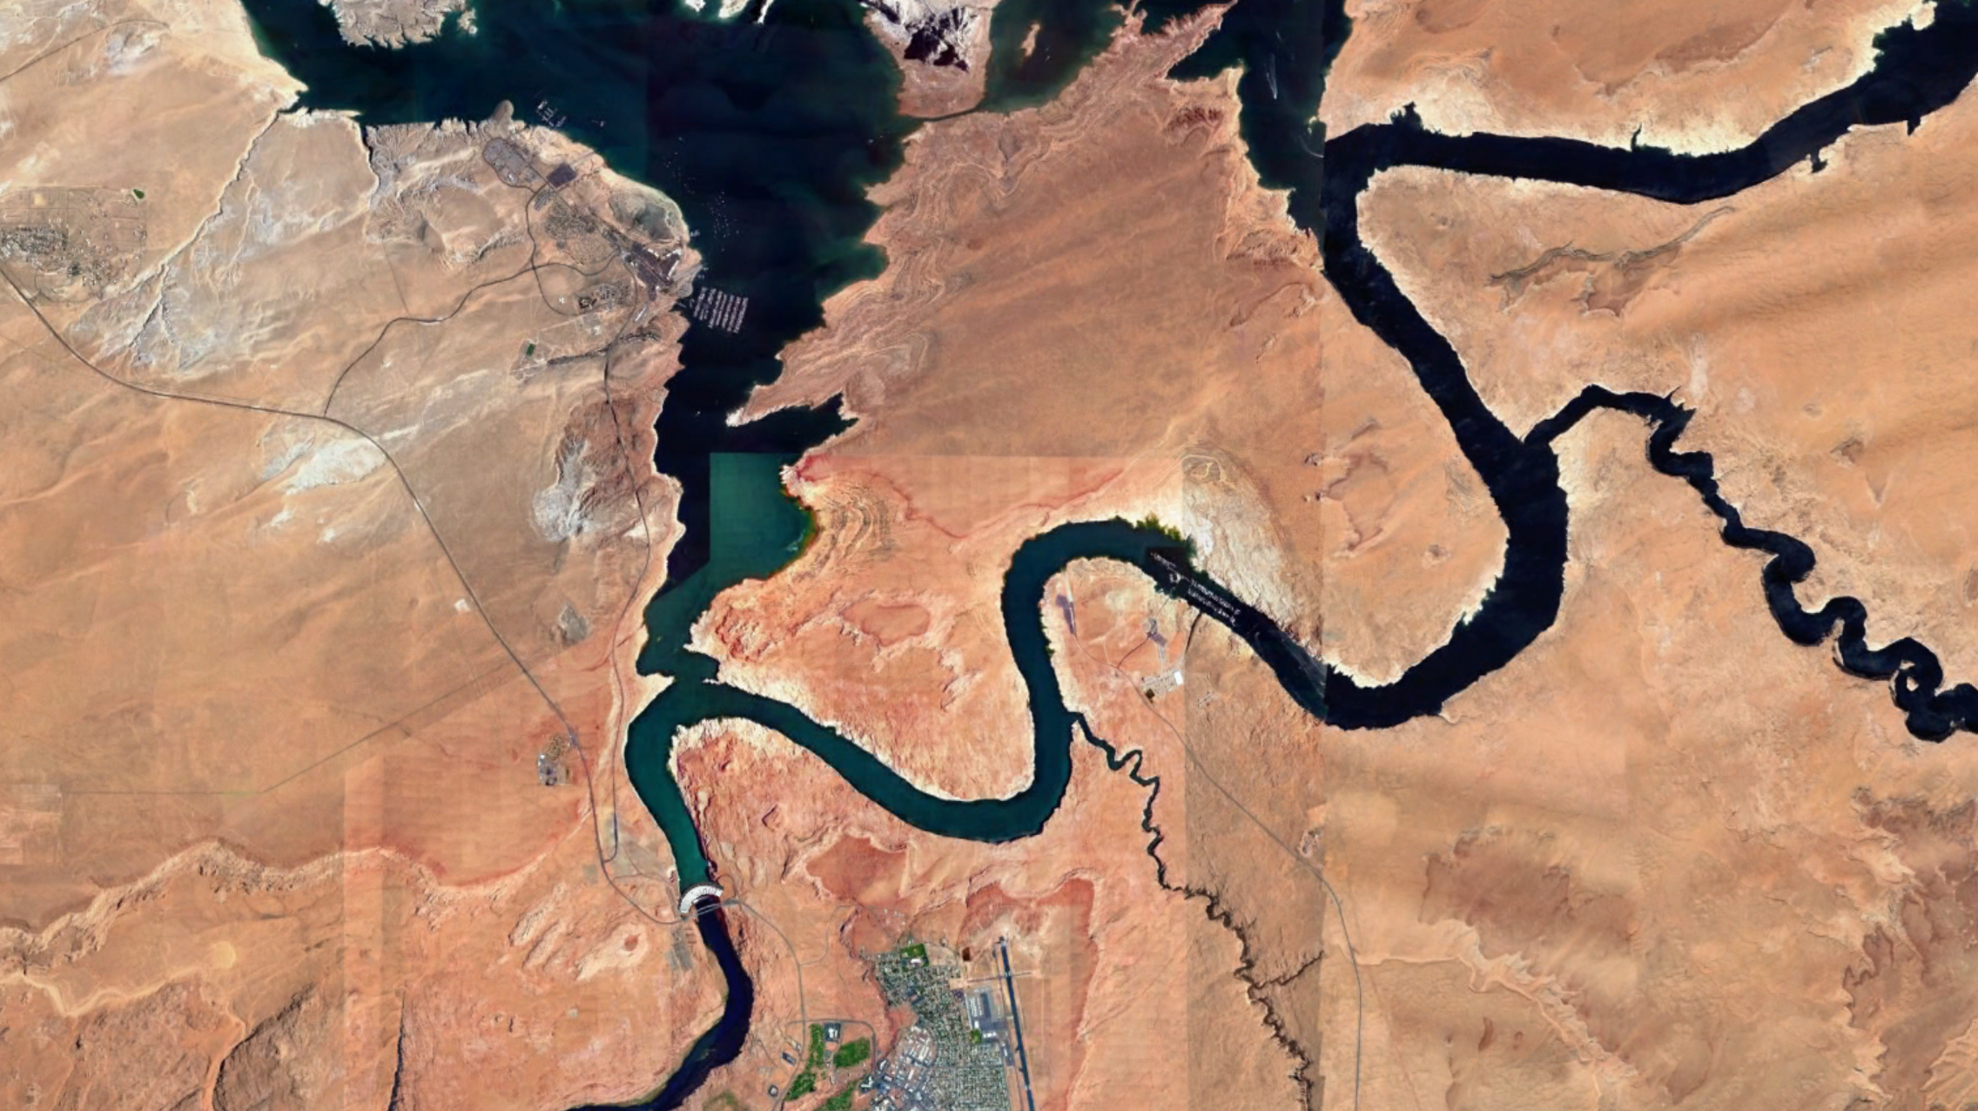
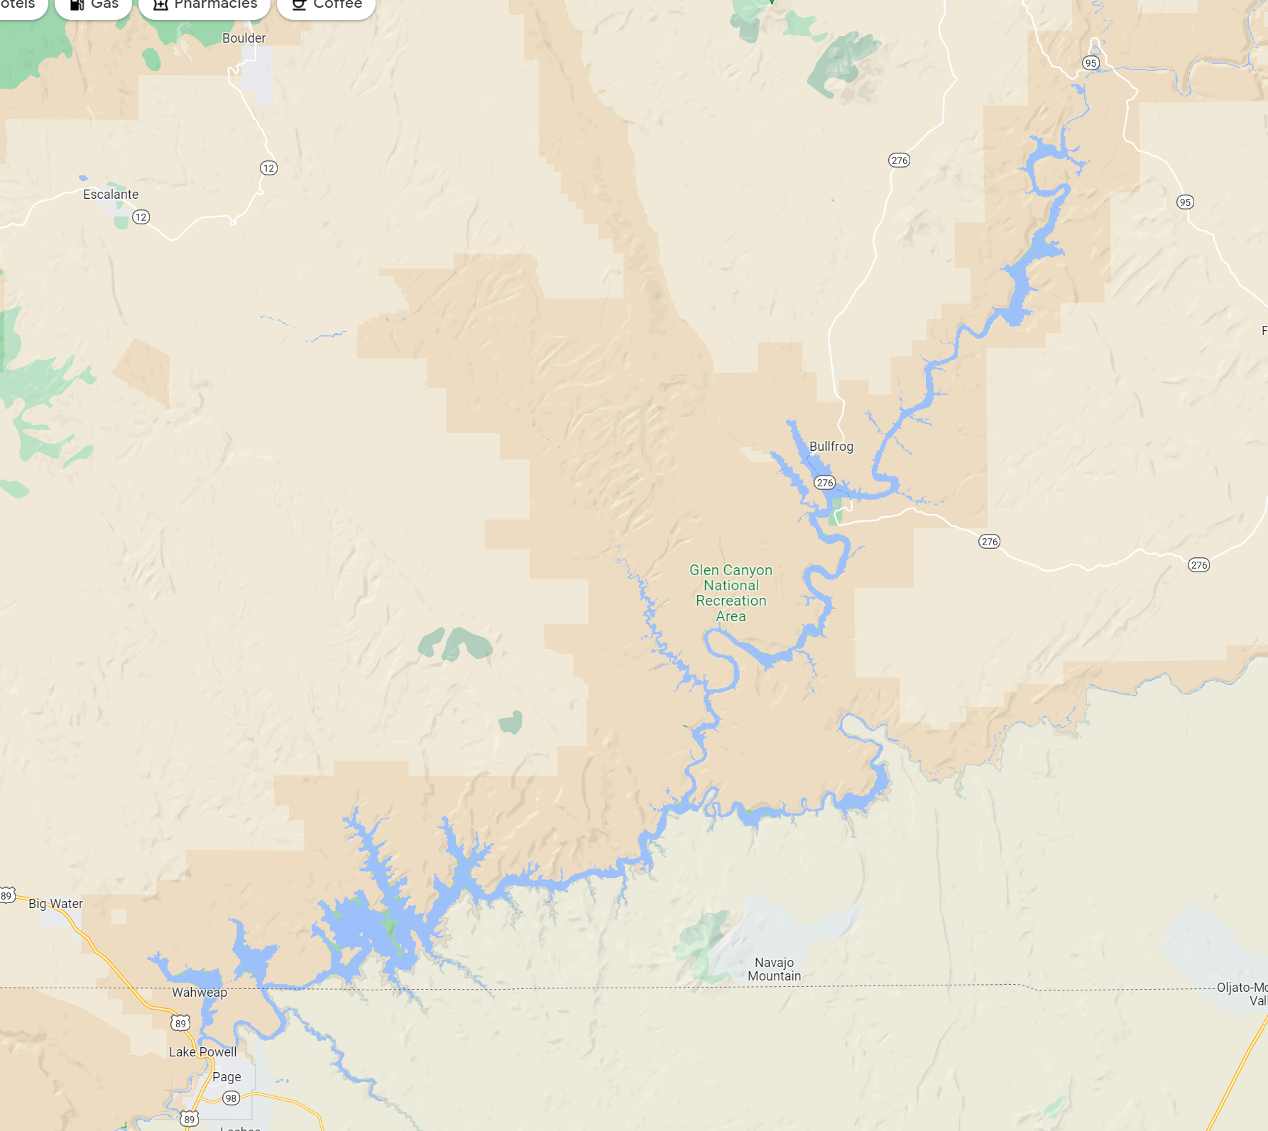
50 km
UT
Study Area
Wahweap
Confluence
Forebay
AZ
Nonnative fish distribution
Risk of entrainment
Survival of entrainment
Glen Canyon Dam
Notes:
As a reminder, I’m attempting to characterize the distribution of nonnative fish in the forebay and identify the likelihood of entrainment.

Slide 5
Updates to TWG
Thermal structure of forebay
Sampling near dam
Sensor Fish preliminary data

Slide 6
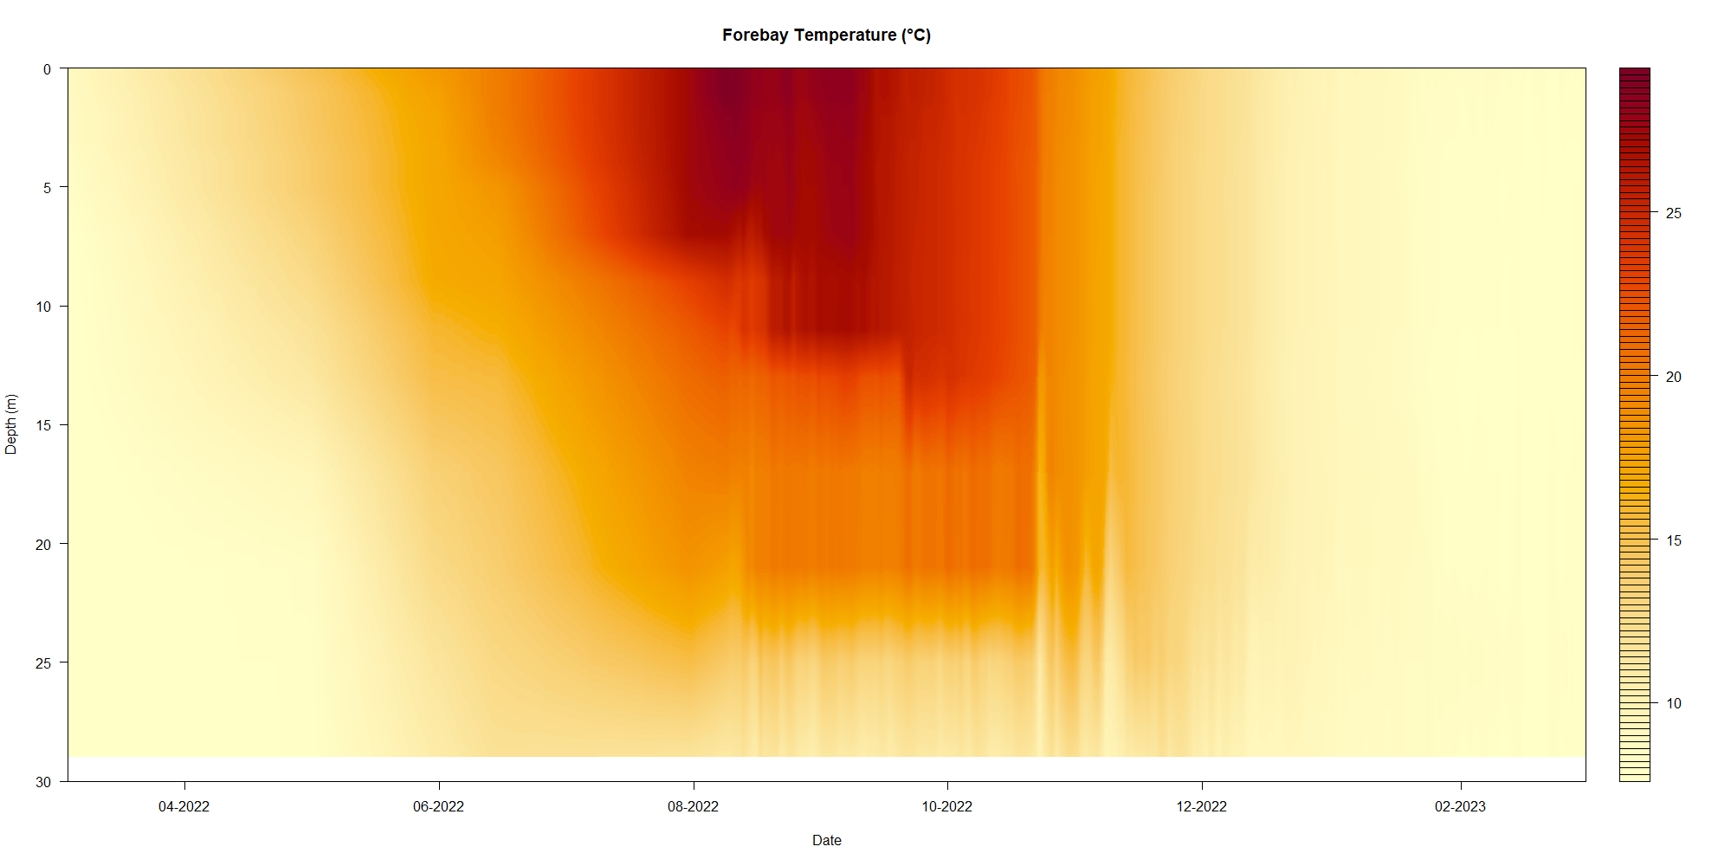

Slide 7
Interpolated
Measured

Slide 8
Epilimnion

Slide 9
Epilimnion
April
December
July
November
Notes:
I’ll start by sharing a series of temperature profiles. The y axis shows descending depth of the reservoir forebay, while the x axis is a measure of the water temperature. As a warm monomicitic water body, Lake Powell is mixed in the winter and is stratified in the summer and fall. The temperature profile taken near the dam back in early March, shown in blue, indicates the reservoir was mixed at that time. Penstock centerline depth is also shown on the graph as a purple dashed line.

Slide 10
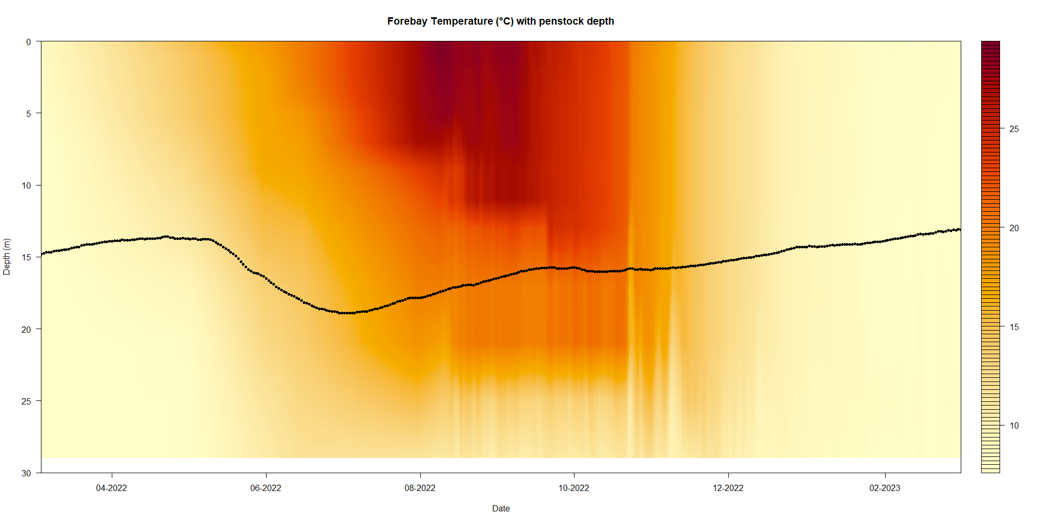
Top of penstock

Slide 11
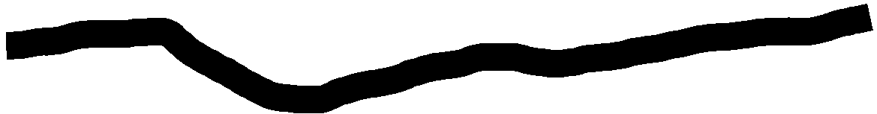
Headed to lower CO River

Slide 12
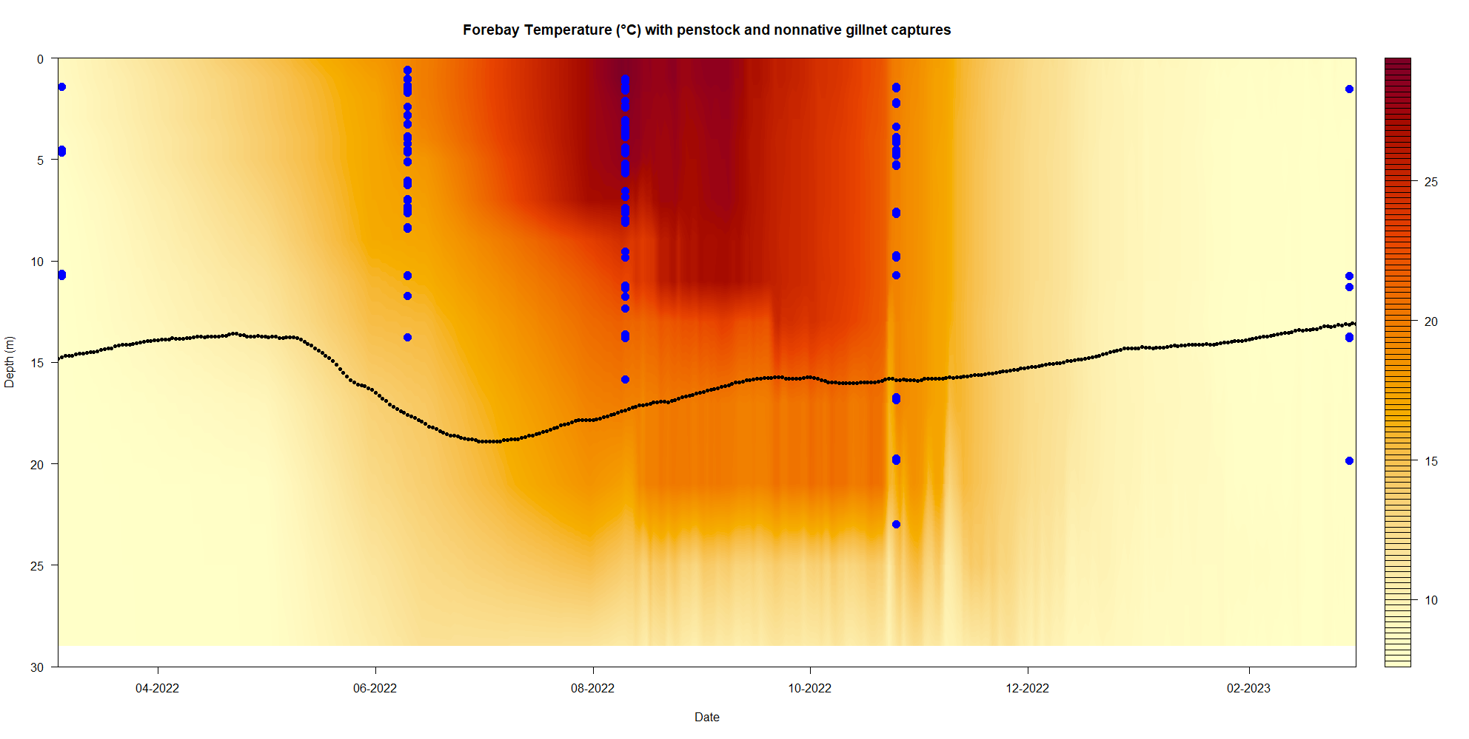

Slide 13
WAE
WAE
GZS
SMB, GZS, WAE
WAE
SMB, GZS, WAE

Slide 14
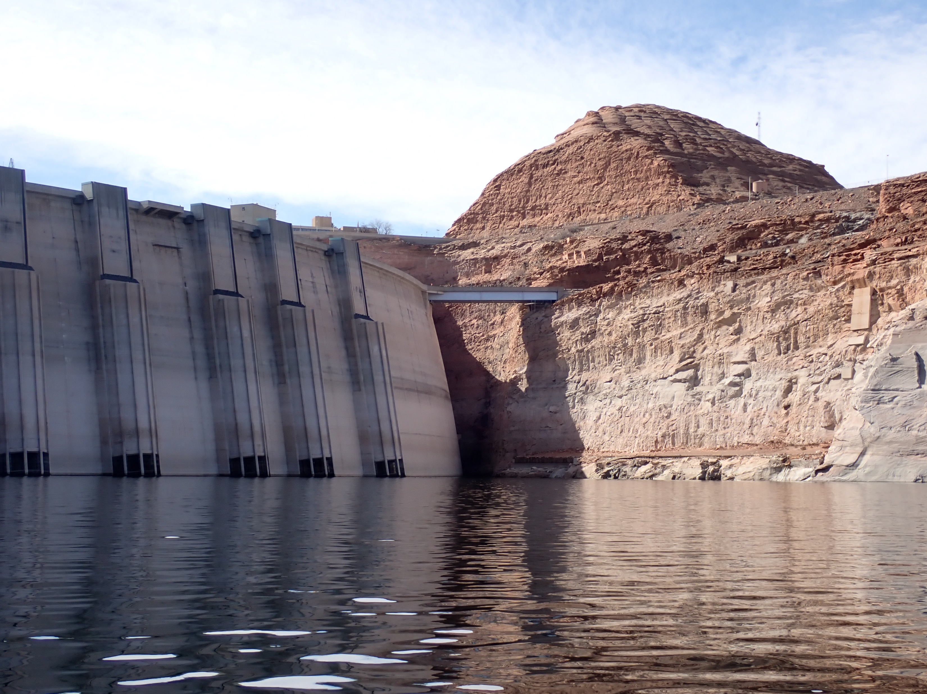
Modification to sampling program: sample within chains close to dam.
Gillnets, minnow traps, larval traps throughout 2023

Slide 15
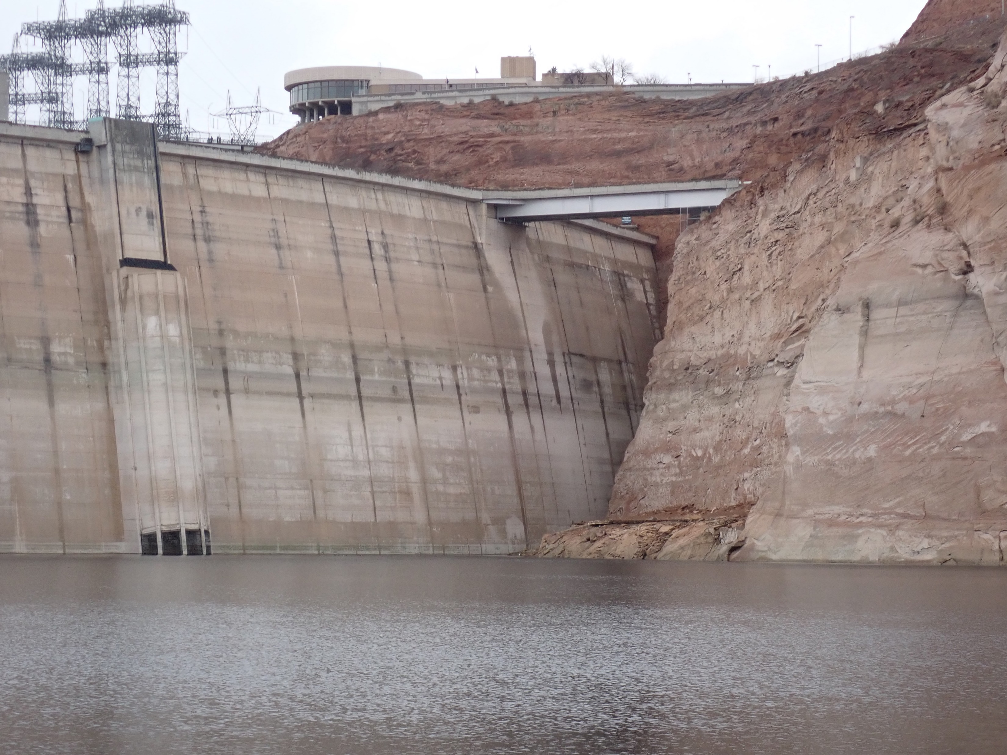
Question from 2022: where are entrained YoY coming from?
Shallow water habitat.
Spawning?

Slide 16
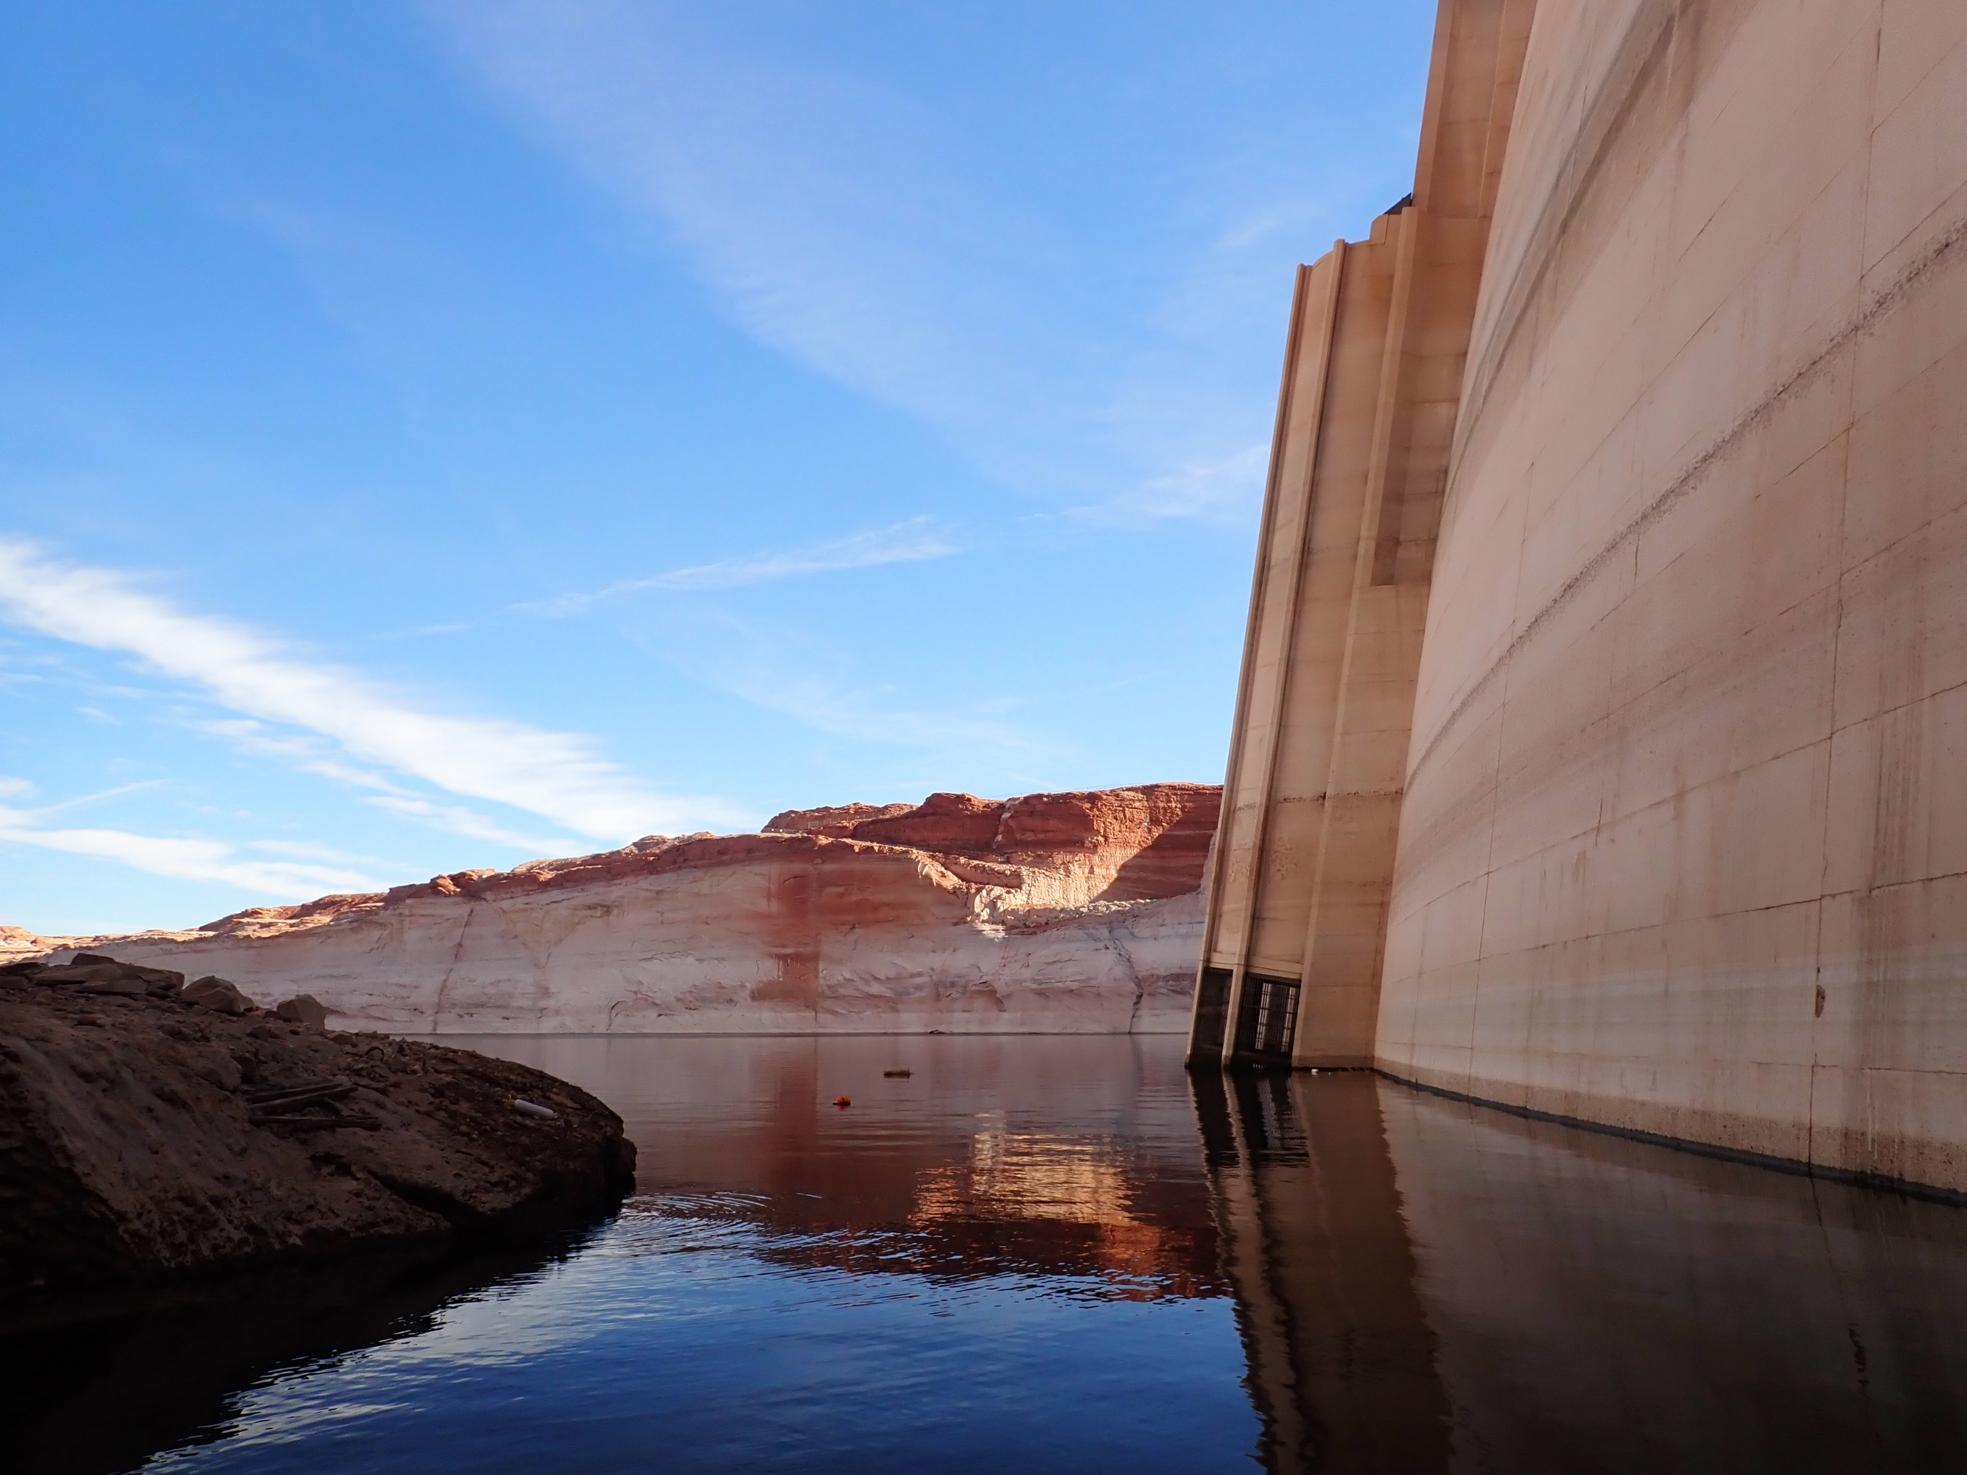
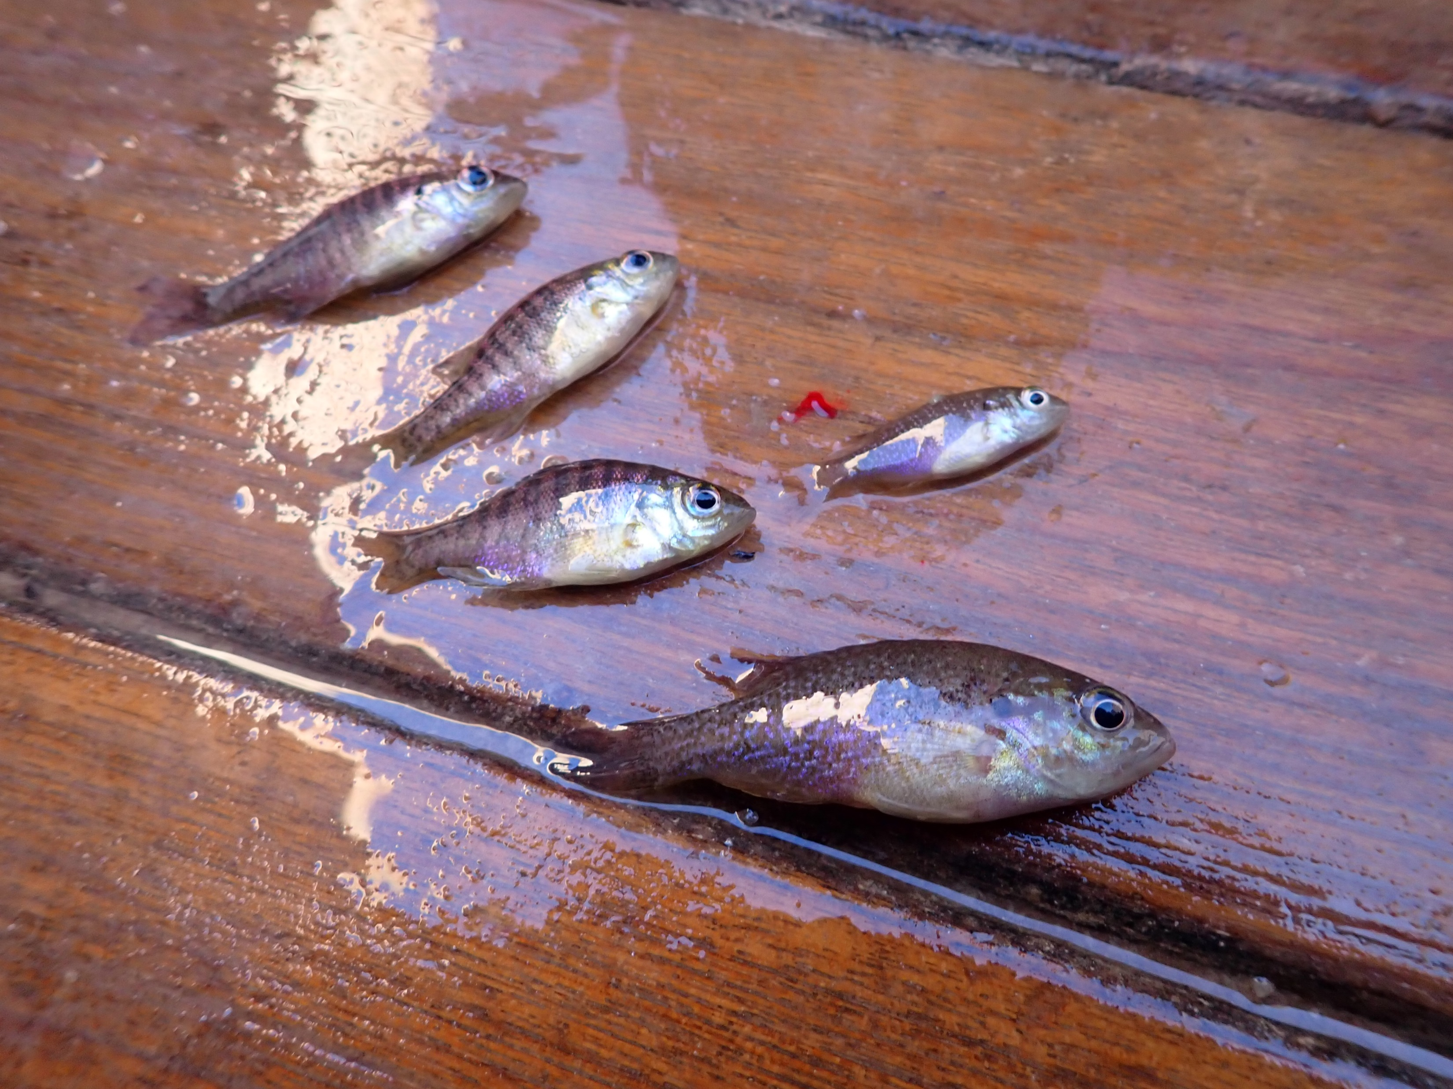
Possible answer: right next to the dam
BGL and GSF captured immediately adjacent to dam
Will we find spawning SMB and YoY there this summer?
Juvenile BGL & GSF

Slide 17
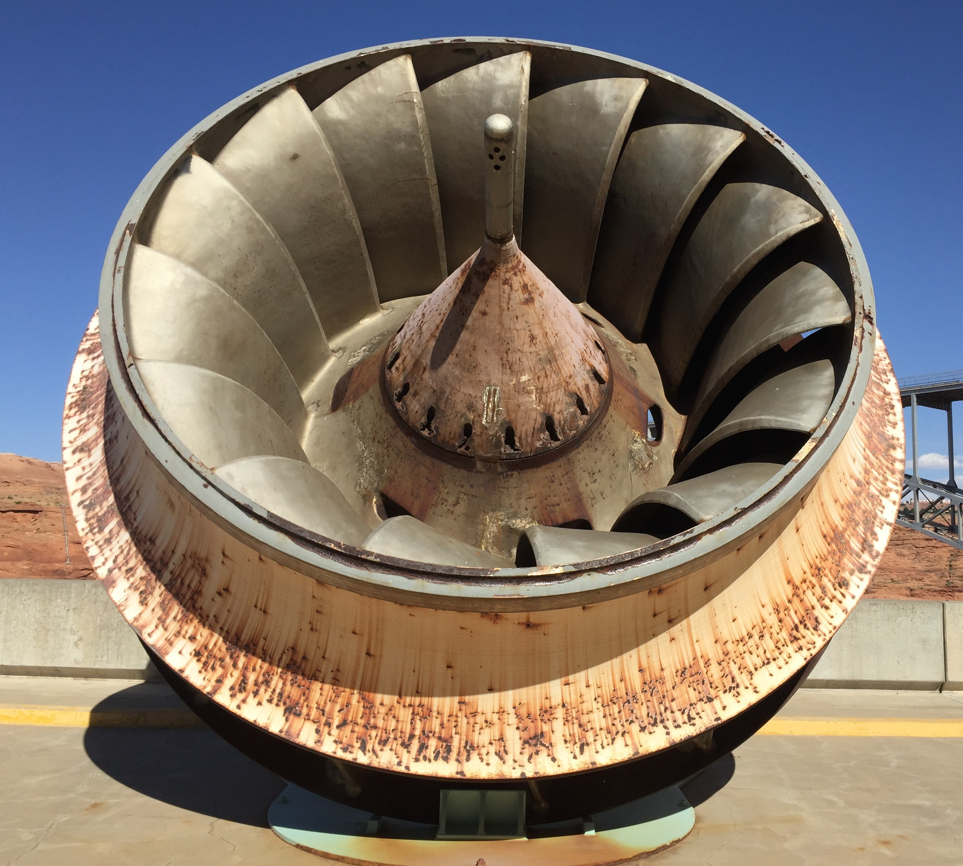
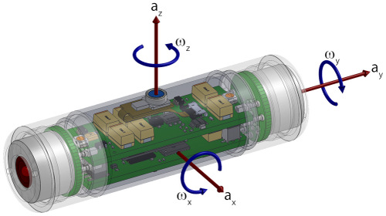
Sensor fish deployed: March 2023
Deployed Sensor Fish through dam to measure conditions of passage
Pressure
Acceleration
17 trials completed
Turbine
Sensor Fish

Slide 18
Sensor fish deployed: March 2023
Sources of immediate and delayed mortality
Turbine blade strike
Injury due to abrasion
Gas bladder rupture
Gas bubble disease
Embolism
Hemorrhage
Exophthalmia

Slide 19
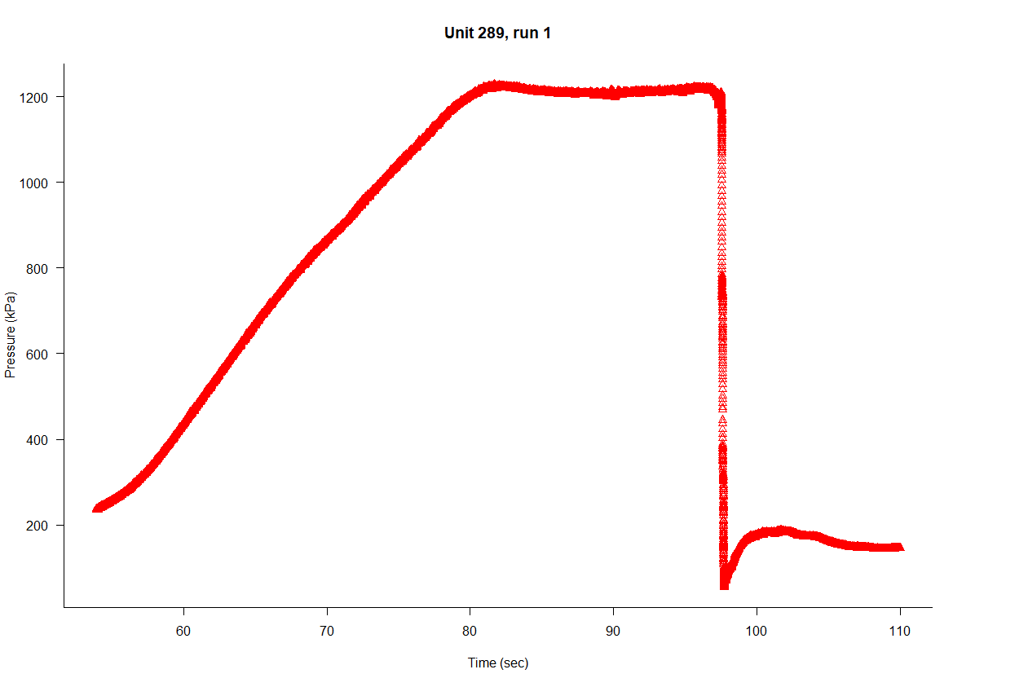
Sensor fish deployed: March 2023
Typical pressure curve
Descending through penstock
Traveling to and through turbine
Exiting turbine
Tailrace
Nadir pressure
Preliminary data

Slide 20
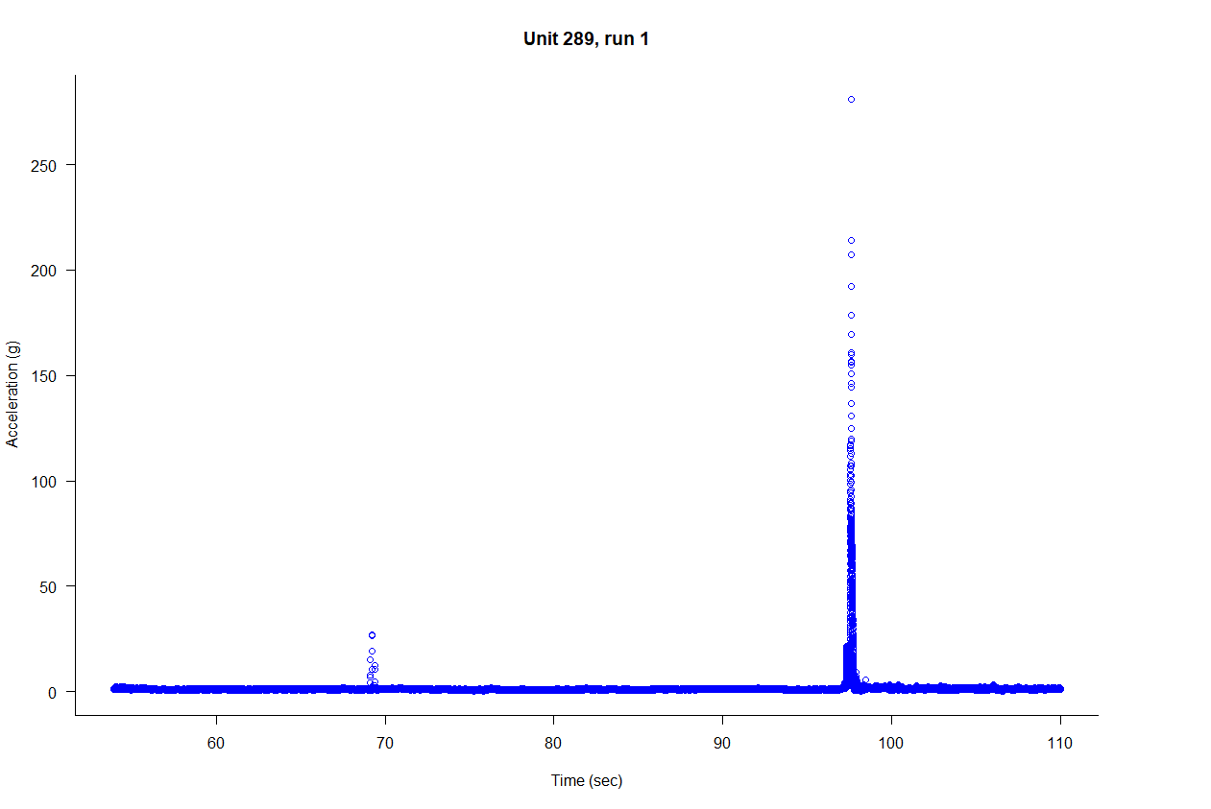
Sensor fish deployed: March 2023
Typical acceleration curve
Exiting turbine
Preliminary data

Slide 21
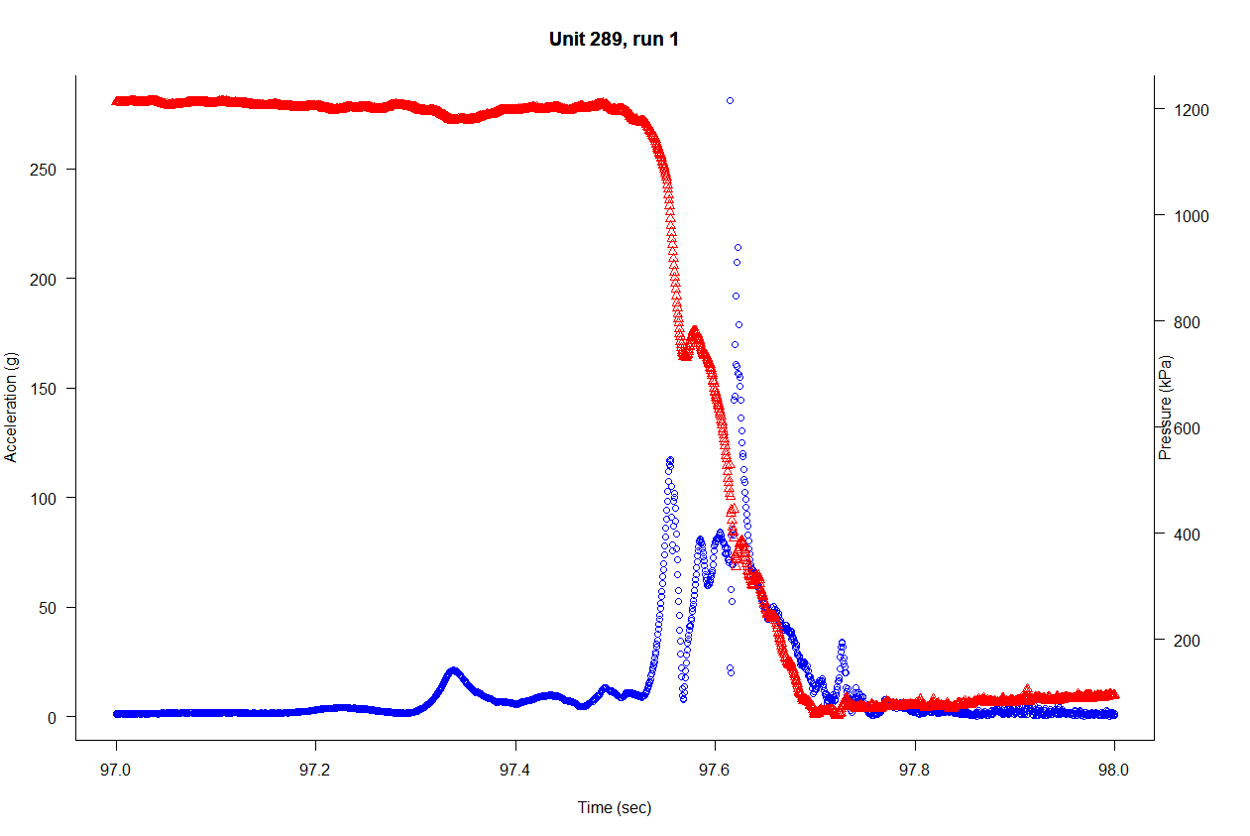
Sensor fish deployed: March 2023
One second of action
Exiting turbine
Preliminary data

Slide 22
Sensor fish deployed: March 2023
Initial findings:
No evidence of turbine strikes
Acclimation pressure dependent upon depth of penstock (water level)
Gas bladder rupture likely
Embolism, hemorrhage, exophthalmia possible due to gas bladder rupture
Gas bubble disease unlikely (short time period, low dissolved gas)
Preliminary data

Slide 23
Sensor fish deployed: March 2023
Initial findings:
No evidence of turbine strikes
Acclimation pressure dependent upon depth of penstock
Gas bladder rupture likely
Embolism, hemorrhage, exophthalmia possible due to gas bladder rupture
Gas bubble disease unlikely (short time period, low dissolved gas in forebay)
Injury/mortality appear linked to change in pressures – no significant effects from turbine passage per se
Preliminary data

Slide 24
Sensor fish deployed: March 2023
Boyle’s Law
P₁V₁=P₂V₂
V₂ = P₁V₁/P₂
Acclimation pressure at penstock intake = P₁ = 237 kPa
Median nadir pressure = P₂ = 36 kPa (atmospheric = 98 kPa)
V₂ = 237(1)/36 = 6.6 (gas bladder expands 6.6x)
From literature:
Gas bladder rupture at 2-4x expansion
84% mortality (Chinook Salmon)
Physostomous vs physoclistous
Life stage implication
Preliminary data

Slide 25
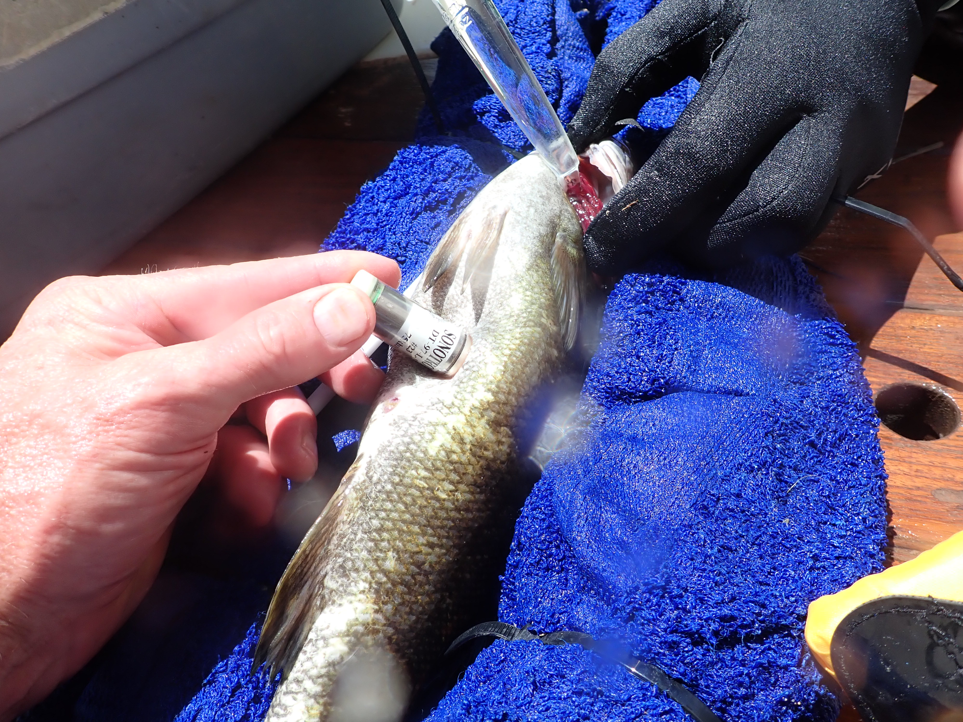
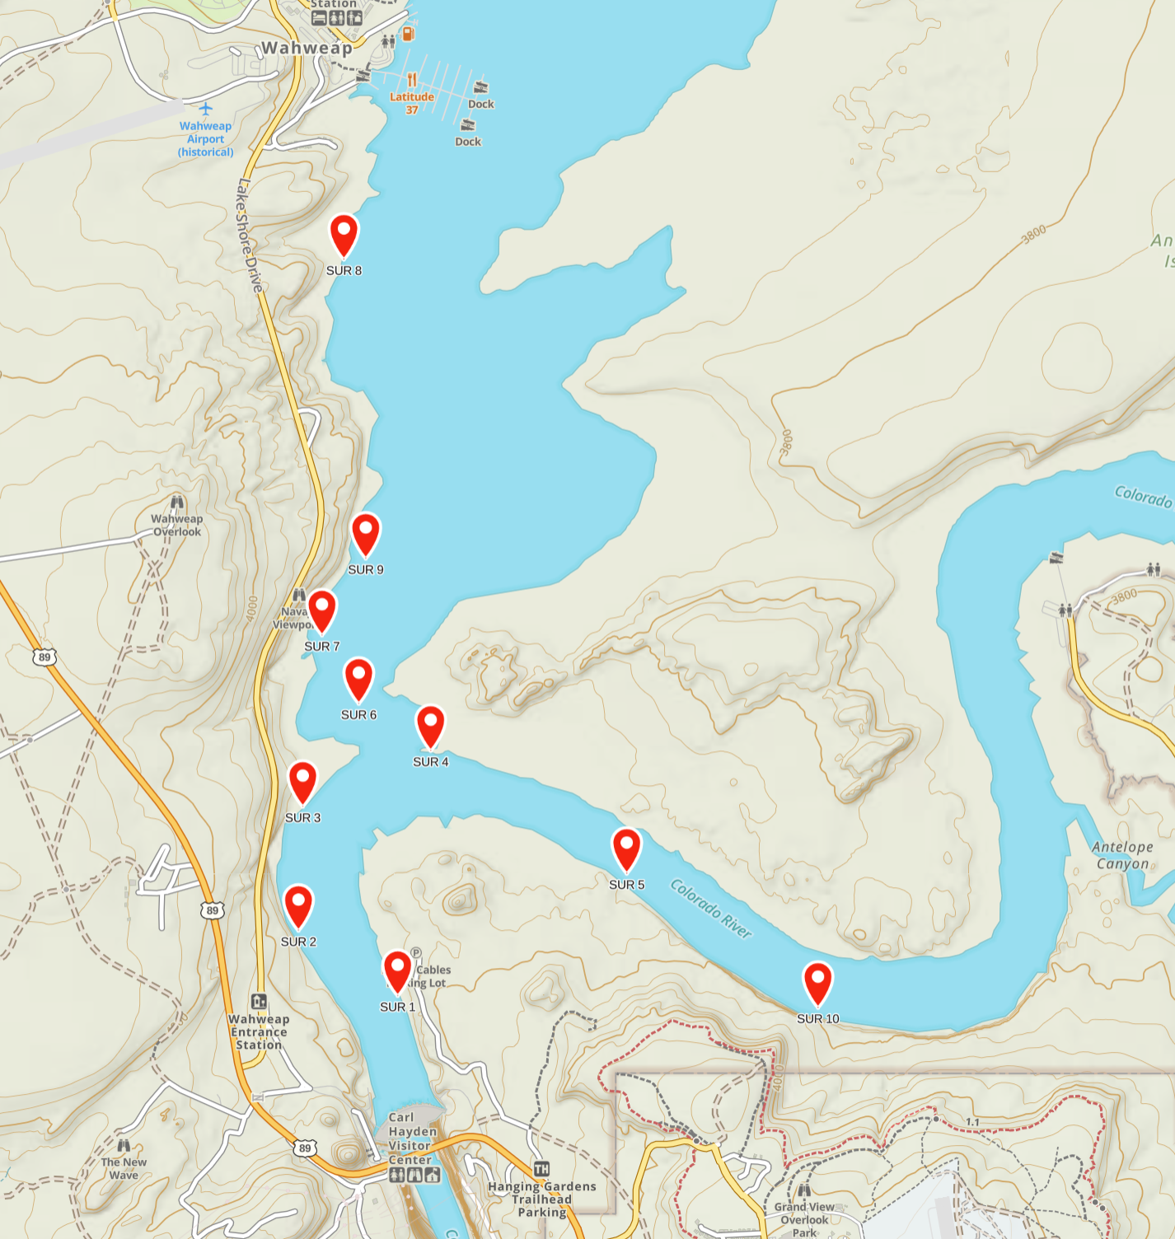
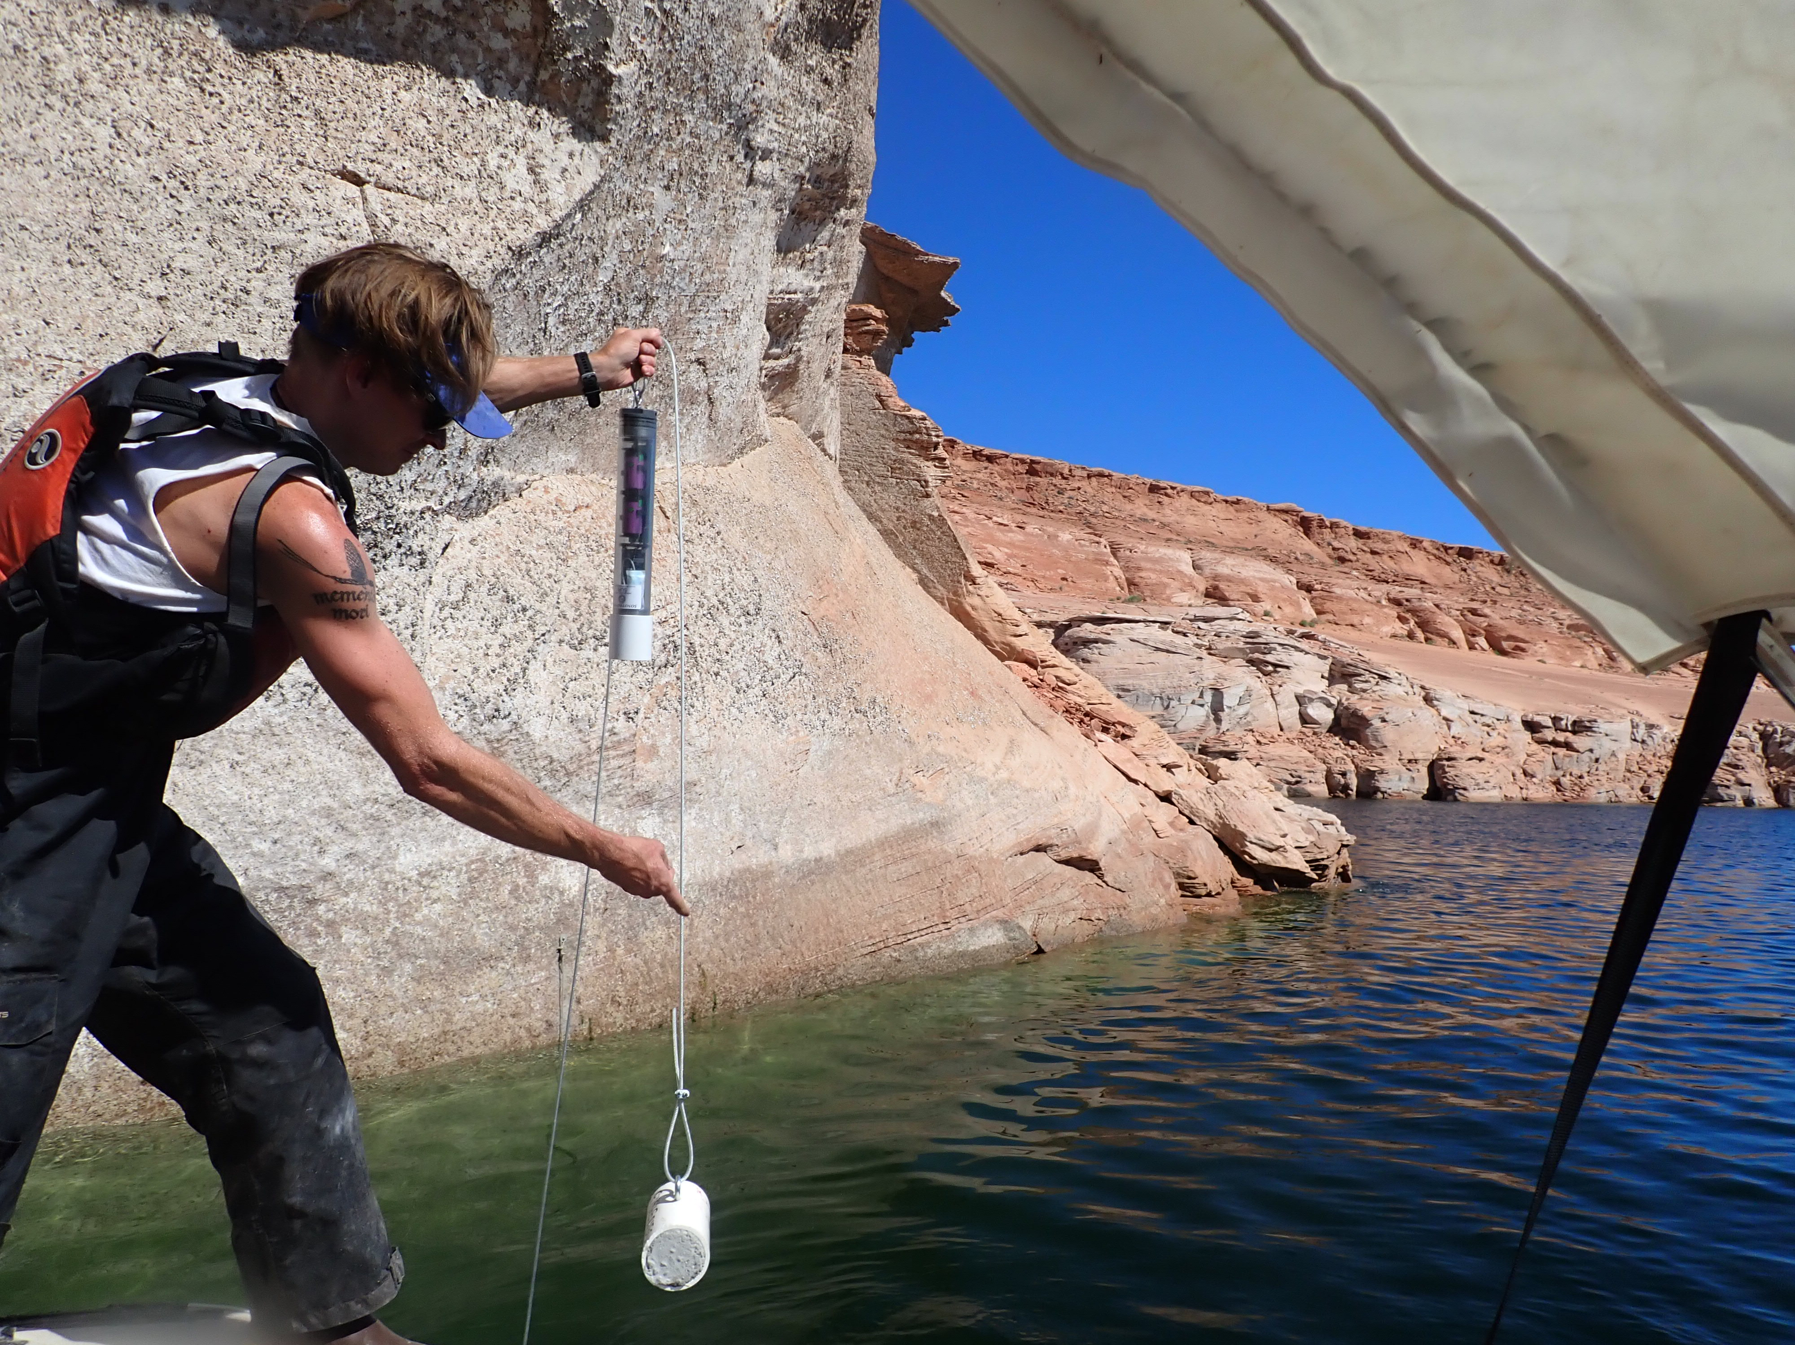
Acoustic telemetry
Movement
Depth
30 fish implanted with ultrasonic transmitters October 2022
20 Smallmouth Bass
10 Channel Catfish
Notes:
To supplement the gillnet, minnow trap, and hydroacoustic data, I have surgically implanted depth sensitive ultrasonic transmitters into 30 fish, which will allow tracking of movement and depth use over the next year. 20 of these fish are Smallmouth Bass and 10 are Channel Catfish. The 10-station submersible ultrasonic receiver network covers my study area.

Slide 26
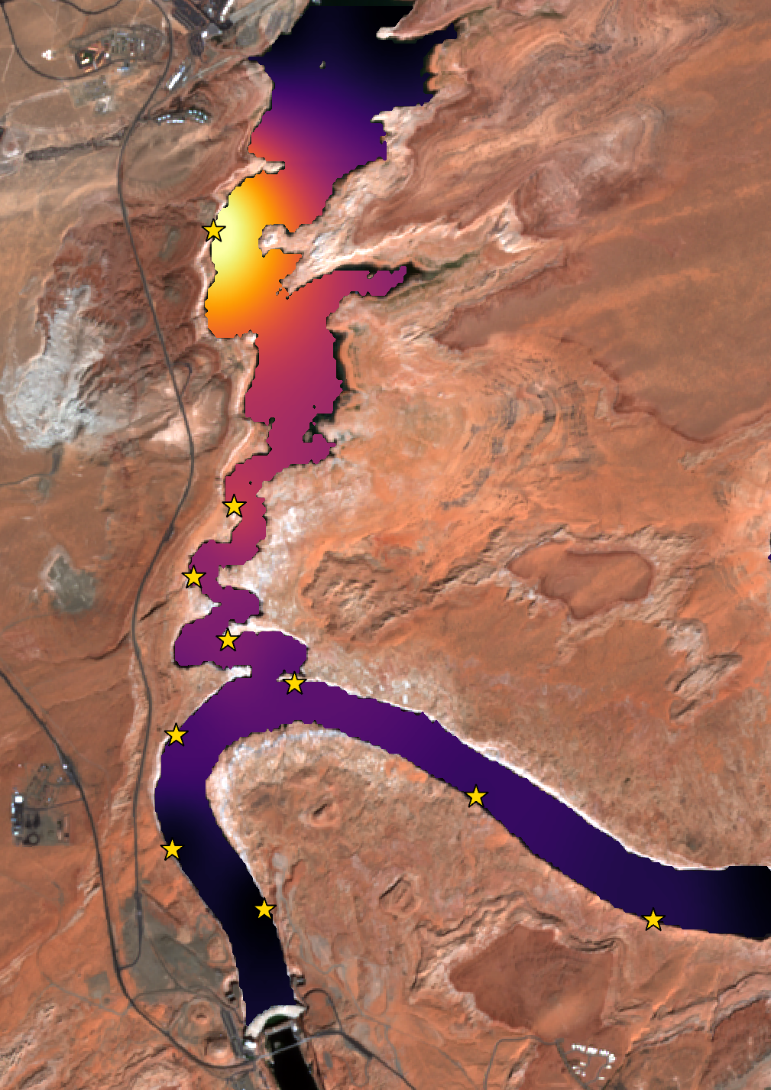
Acoustic telemetry
Where have the 30 fish traveled?
Unique fish detections higher near Wahweap, zero detected at dam
Expectation: fish will move into forebay as water warms and epilimnion forms
24
12
9
8
6
5
4
1
0
3
Notes:
This acoustic telemetry network will provide a wealth of movement and depth data, and here I’m showing unique detections in my receiver network in November and December 2022. The actual values are noted, and I’ve overlaid a heat map on top to show the trend. In the northern part of my study area near Wahweap, 23 of the 30 tagged fish were detected, while the receiver in the forebay closest to the dam did not detect any fish during that timeframe. I expect these tagged fish to move into the forebay as the epilimnion develops this summer.

Slide 27
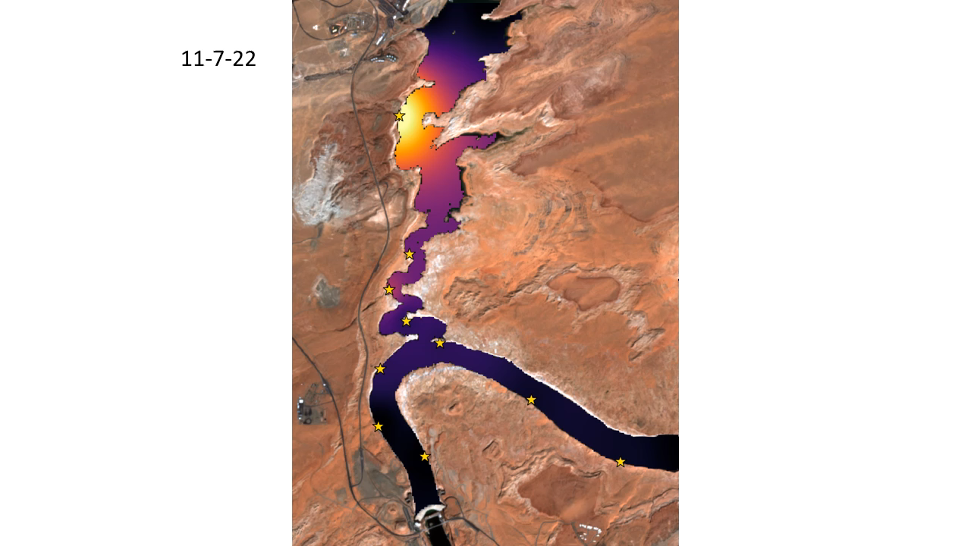
Notes:
This acoustic telemetry network will provide a wealth of movement and depth data, and here I’m showing unique detections in my receiver network in November and December 2022. The actual values are noted, and I’ve overlaid a heat map on top to show the trend. In the northern part of my study area near Wahweap, 23 of the 30 tagged fish were detected, while the receiver in the forebay closest to the dam did not detect any fish during that timeframe. I expect these tagged fish to move into the forebay as the epilimnion develops this summer.

Slide 28
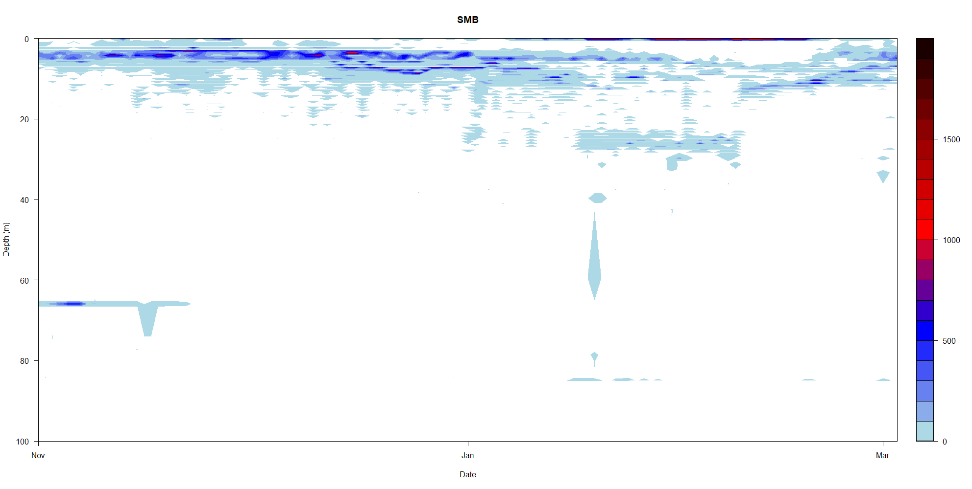
Acoustic telemetry
What depths?
Date range: Nov 1 to Mar 5
Most detections <10 m
Smallmouth Bass (20 fish implanted)
n = 230,000
Notes:
I can also plot depth usage over time for my tagged fish. Here I’ve made a heat map of depth on the y axis vs time on the x axis for all detections in November and December, which was about 180,000 total detections in that timespan. You can see the darker band indicating a greater number of detections up quite shallow. On the right I’m showing the exact same data on depth histogram. As the water warms in the spring and summer, I expect these fish to occupy greater depths throughout the epilimnion.

Slide 29
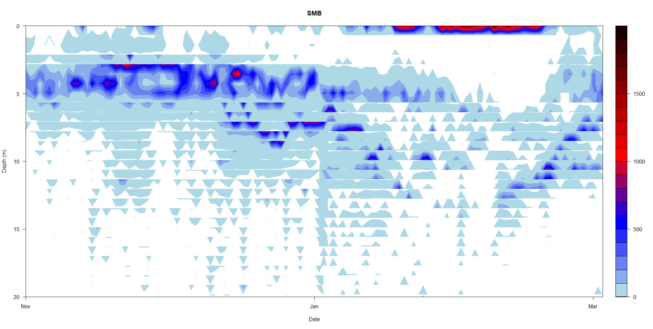
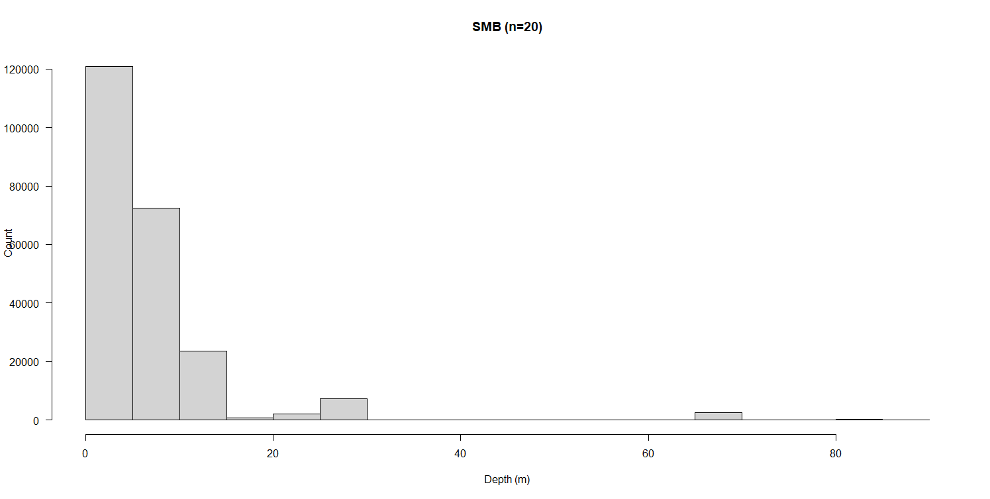
Acoustic telemetry
What depths?
Date range: Nov 1 to Mar 5
Most detections <10 m
Smallmouth Bass (20 fish implanted)
Depth: 0 – 10 m
Notes:
I can also plot depth usage over time for my tagged fish. Here I’ve made a heat map of depth on the y axis vs time on the x axis for all detections in November and December, which was about 180,000 total detections in that timespan. You can see the darker band indicating a greater number of detections up quite shallow. On the right I’m showing the exact same data on depth histogram. As the water warms in the spring and summer, I expect these fish to occupy greater depths throughout the epilimnion.

Slide 30
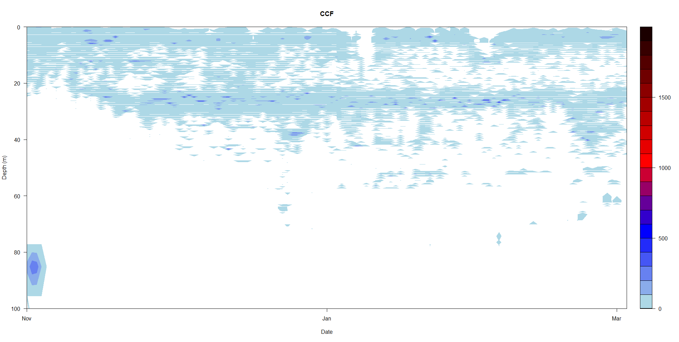
Acoustic telemetry
What depths?
Date range: Nov 1 to Mar 5
Most detections <50 m
Channel Catfish (10 fish implanted)
n = 160,000
Notes:
I can also plot depth usage over time for my tagged fish. Here I’ve made a heat map of depth on the y axis vs time on the x axis for all detections in November and December, which was about 180,000 total detections in that timespan. You can see the darker band indicating a greater number of detections up quite shallow. On the right I’m showing the exact same data on depth histogram. As the water warms in the spring and summer, I expect these fish to occupy greater depths throughout the epilimnion.

Slide 31
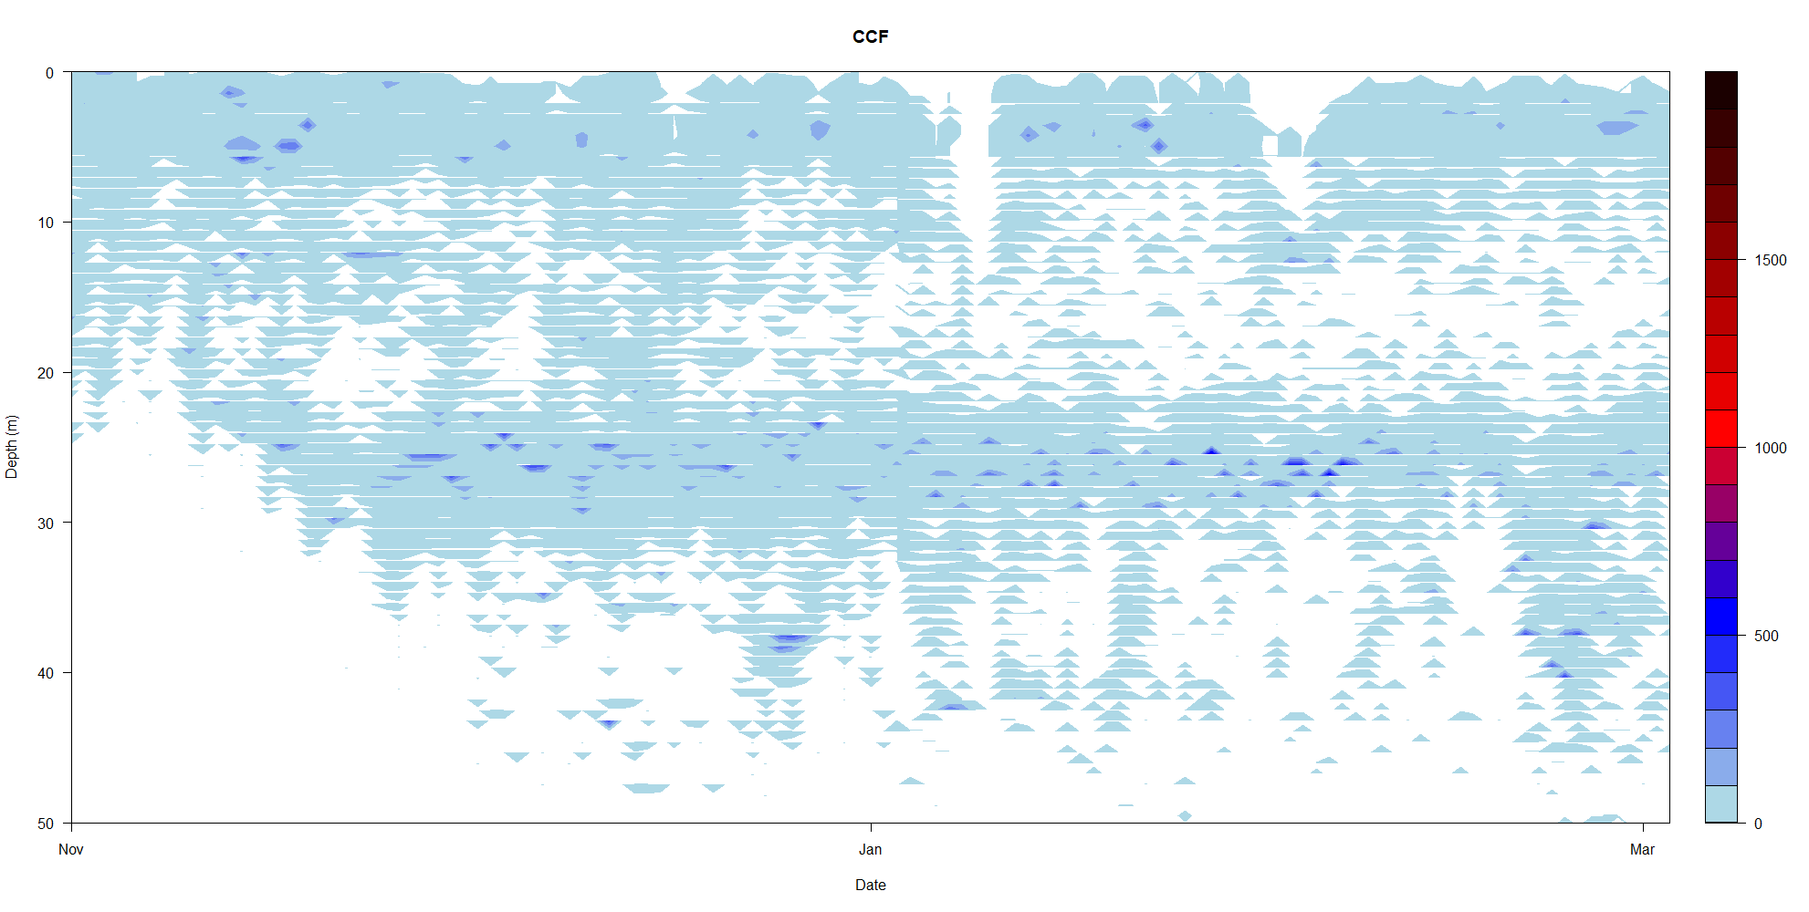
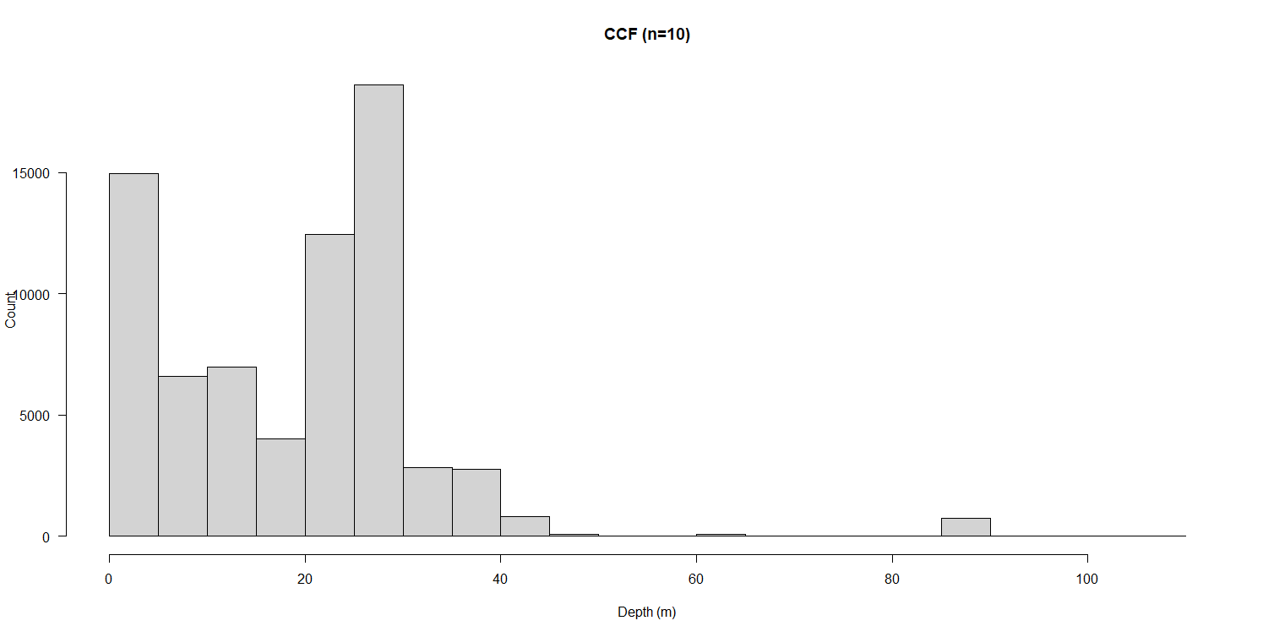
Acoustic telemetry
What depths?
Date range: Nov 1 to Mar 5
Most detections <50 m
Channel Catfish (10 fish implanted)
Depth: 0 – 50 m
Notes:
I can also plot depth usage over time for my tagged fish. Here I’ve made a heat map of depth on the y axis vs time on the x axis for all detections in November and December, which was about 180,000 total detections in that timespan. You can see the darker band indicating a greater number of detections up quite shallow. On the right I’m showing the exact same data on depth histogram. As the water warms in the spring and summer, I expect these fish to occupy greater depths throughout the epilimnion.

Slide 32
Relative Probability of Entrainment (PoE)
Probability of presence at depth given:
Season (stratification)
Water temp
Location
Species
Work on model database setup has begun, exact form of model TBD

Slide 33
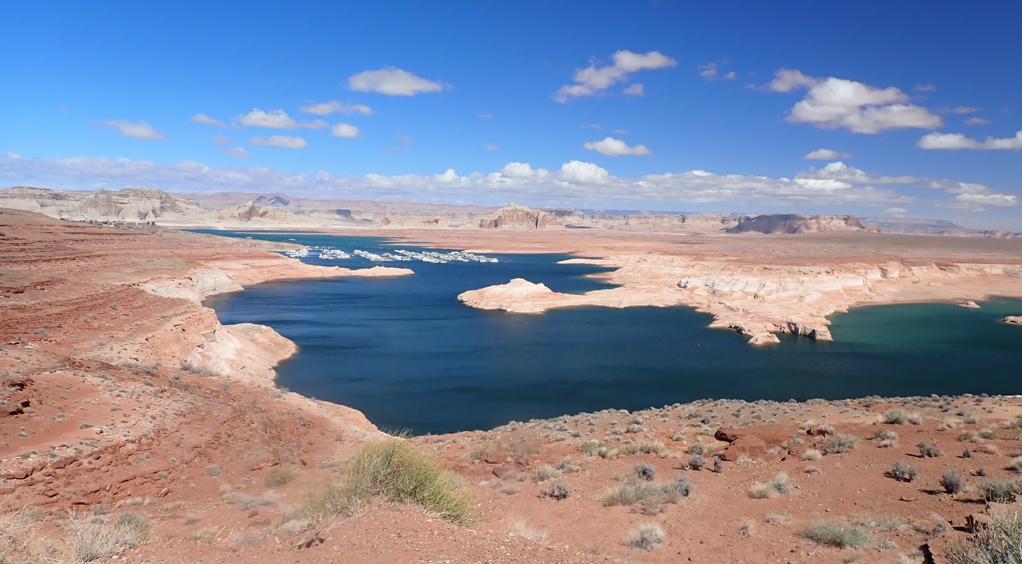
Acknowledgments
Bureau of Reclamation
Kato Miyagishima
Clarence Fullard
Mike Horn
Kerri Pedersen
Mark McKinstry
Utah State University
David Rosenberg
Gary P. Thiede
Justin Furby
Hunter Pehrson
Ben Miller
Martinique Chavez
Sarah Barnes
National Park Service
Jeff Arnold
U.S. Geological Survey
USGS Utah Cooperative Fish & Wildlife Research Unit
Notes:
Despite the challenges, I’m excited for this coming year, and I’d like to thank everyone who makes this project possible, especially the sponsoring organization, the Bureau of Reclamation, particularly Clarence Fullard and Mike Horn there. I’d be happy to take your questions at this time.

Slide 34
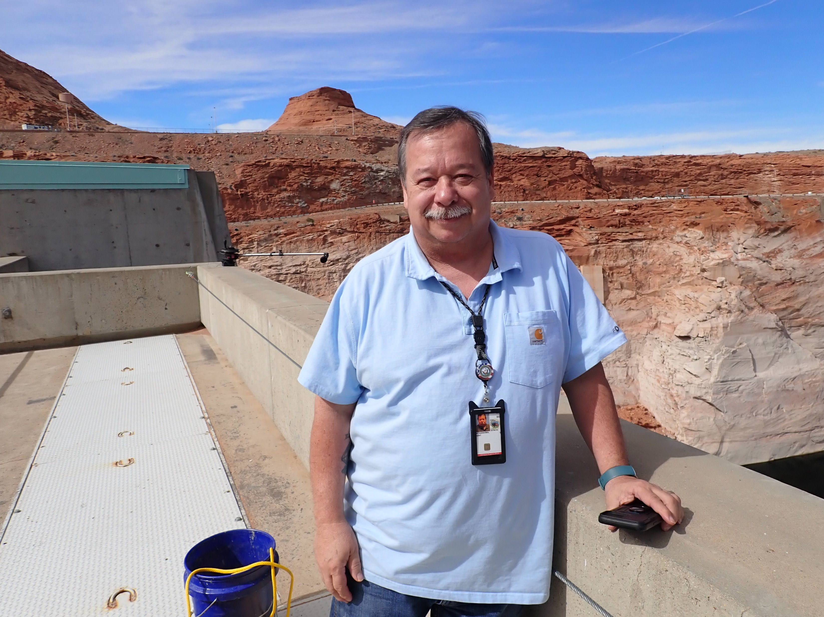
Acknowledgments
Bureau of Reclamation
Kato Miyagishima
Clarence Fullard
Mike Horn
Kerri Pedersen
Mark McKinstry
Utah State University
David Rosenberg
Gary P. Thiede
Justin Furby
Hunter Pehrson
Ben Miller
Martinique Chavez
Sarah Barnes
National Park Service
Jeff Arnold
U.S. Geological Survey
USGS Utah Cooperative Fish & Wildlife Research Unit
Notes:
Despite the challenges, I’m excited for this coming year, and I’d like to thank everyone who makes this project possible, especially the sponsoring organization, the Bureau of Reclamation, particularly Clarence Fullard and Mike Horn there. I’d be happy to take your questions at this time.

